Slide 1
URBAN MOBILITY IN A DIGITAL AGE
Jay W. Kim, P.E.
Assistant General Manager

Slide 2
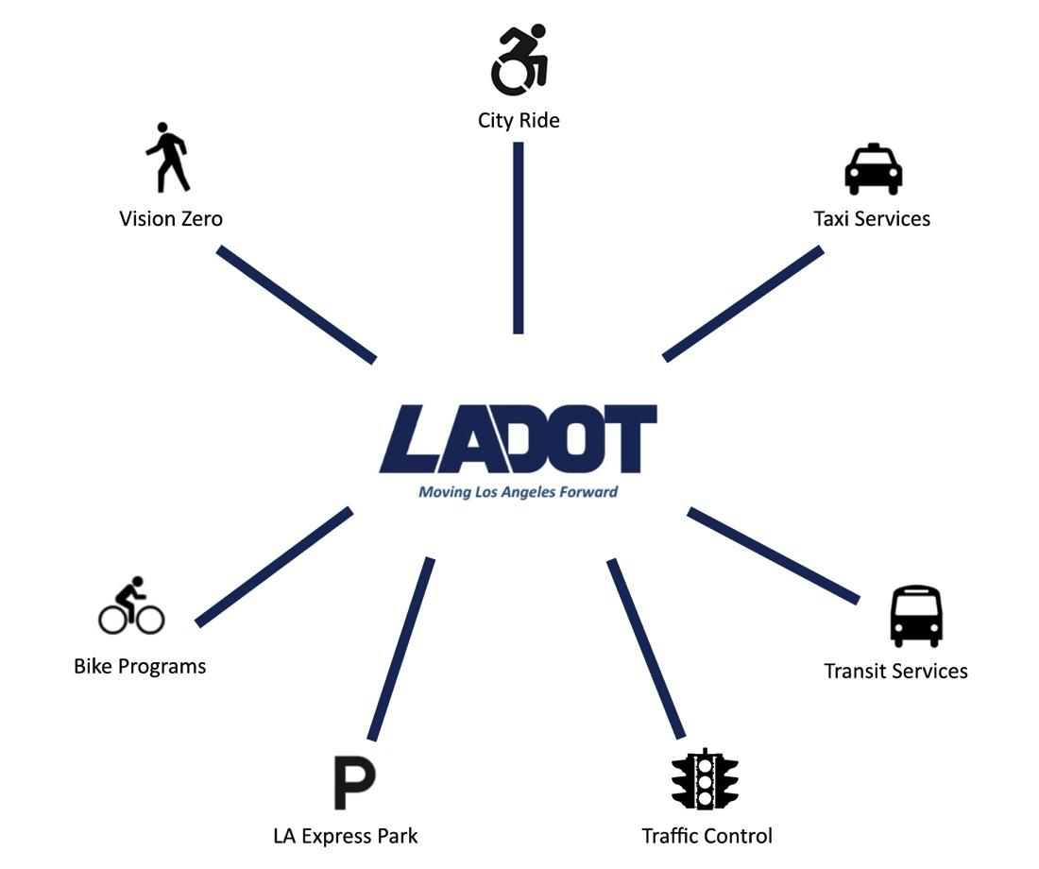
LADOT Factoid
2,190 Employees
$160M Operating Budget
Land Area 468 Square Miles
Streets 7500 Miles
4,689 Signals
37,000 Meters
2.3 million Citations
$140 million citation revenue
$60 million parking revenue
359 Transit Fleet Vehicles

Slide 3
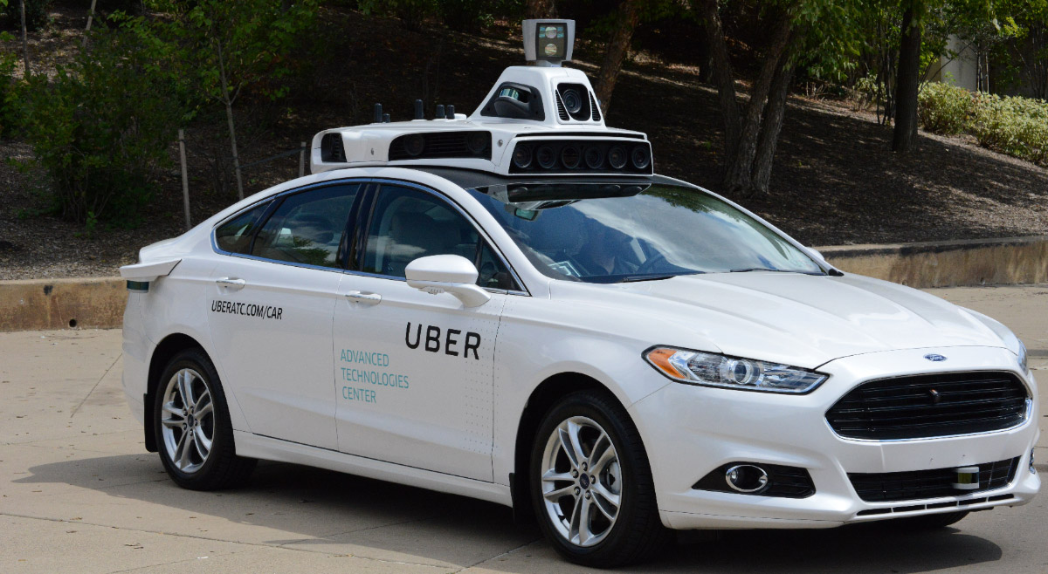
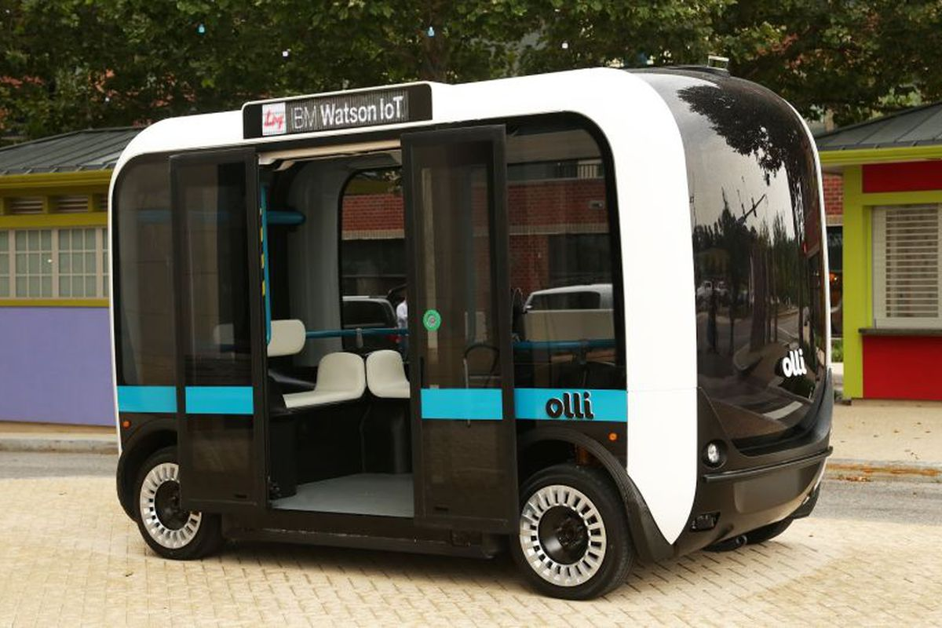
New Technology and Disruptive Services

Slide 4
How we manage the system today
Build Infrastructure (Roads, Signals)
Develop Regulations (Ordinances, Rules and Regs)
Provide Services (Public Transit, Taxi)
Enforce Violations (Issue Citations, Tow Vehicles)
Analog platform defined by street signs, signals, paint and concrete
Need to transition to a digital system

Slide 5
How we need to manage in the future
Digital Platform
<CODE/> is the new CONCRETE
Need to build a digital infrastructure
API, machine learning, the cloud
Future decisions needs to be based on real-time data and data analytics
Need real-time routing and pricing engines
Need to manage movement on the ground and air

Slide 6
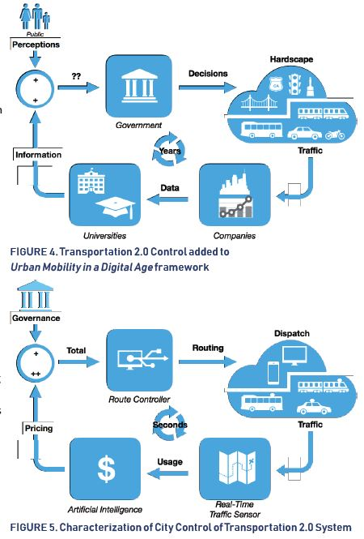
Analog
Digital

Slide 7
HOW IS THE CITY OF LA GETTING READY?
Vision Document

Slide 8
HOW IS THE CITY OF LA GETTING READY?
New Construct: Transportation 2.0
Real-Time Data and Analytics
API, Algorithms, Hosted on the Cloud
Routing Engine
Pricing Engine
Automated Decision Making Capabilities

Slide 9
Digitize Physical Assets

Slide 10
Build a Solid Data Foundation
Data Implementation Plan
Digital Data Inventory
Data Fluency and GIS Training
Data Exchange Platform

Slide 11
Build a Solid Data Foundation
Mobility Data Specification (MDS) Workshop 9-12-18
“A data standard and API specification for mobility as a service providers , such as dockless bike share, e-scooters, and shared ride providers who work within the public right of way”
Notes:
”So what is MDS or the Mobility Data Specification. Read Quote. The specification contains a data standard to define a RESTful API that municipalities can access during the pilot phase of the program.
We will be able to query through the MDS Restful API or Application Program Interface beginning with the Provider API
The specification allows for insights into constituent transportation behavior with trip routes and trip times data. With the Provider API, the specification allows access into mobility provider behavior with company specific data conveying fleet sizes, maintenance responsiveness, equity compliance, route information, status changes, batter info, event types, service areas, etc. in real time.

Slide 12
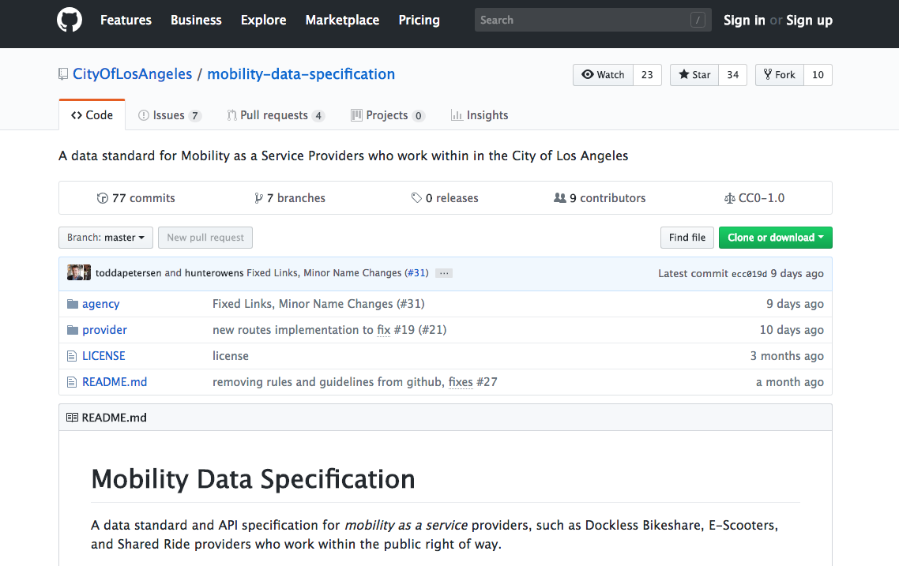
Mobility Data Specification (MDS)
Notes:
In May 2018 we released the Mobility Data Specification was released on Github to allow for opensource collaboration
So what is Github you might be asking? If you have heard of Bitcoin you have heard of Github. It is what was used to create it.
Github is like Wikipedia for programmers. You can edit files, see who changed what, view old versions of files, and access it from anywhere in the world.
Github allows groups of developers to collaborate on the same programming scripts simultaneously and without overriding each other’s work.

Slide 13
Mobility Data Specification (MDS)
VEHICLE REGISTRATION
register_vehicle Endpoint (post)
Key | Field | Type | Description
* | unique_id | UUID | UUID v4 provided by Operator to uniquely identify a vehicle
 | provider_id | string | Unique service provider identifier that will be issued by the City as part of the permit application process.
 | vehicle_id | string | Vehicle identification number
 | registration_status | enum | Status of the record (Active / Inactive)
 | vehicle_type | enum | Vehicle Type
 | propulsion_type | enum | Type of propulsion
 | vehicle_year | enum | Year manufactured
 | vehicle_mfgr | enum | Manufacturer name
 | vehicle_model | enum | Vehicle model name
 | vehicle_status1 | enum | Event_type from MDS Event Types table
 | vehicle_status2 | enum | Reason from MDS Event Types table
Notes:
In May 2018 we released the Mobility Data Specification was released on Github to allow for opensource collaboration
So what is Github you might be asking? If you have heard of Bitcoin you have heard of Github. It is what was used to create it.
Github is like Wikipedia for programmers. You can edit files, see who changed what, view old versions of files, and access it from anywhere in the world.
Github allows groups of developers to collaborate on the same programming scripts simultaneously and without overriding each other’s work.

Slide 14
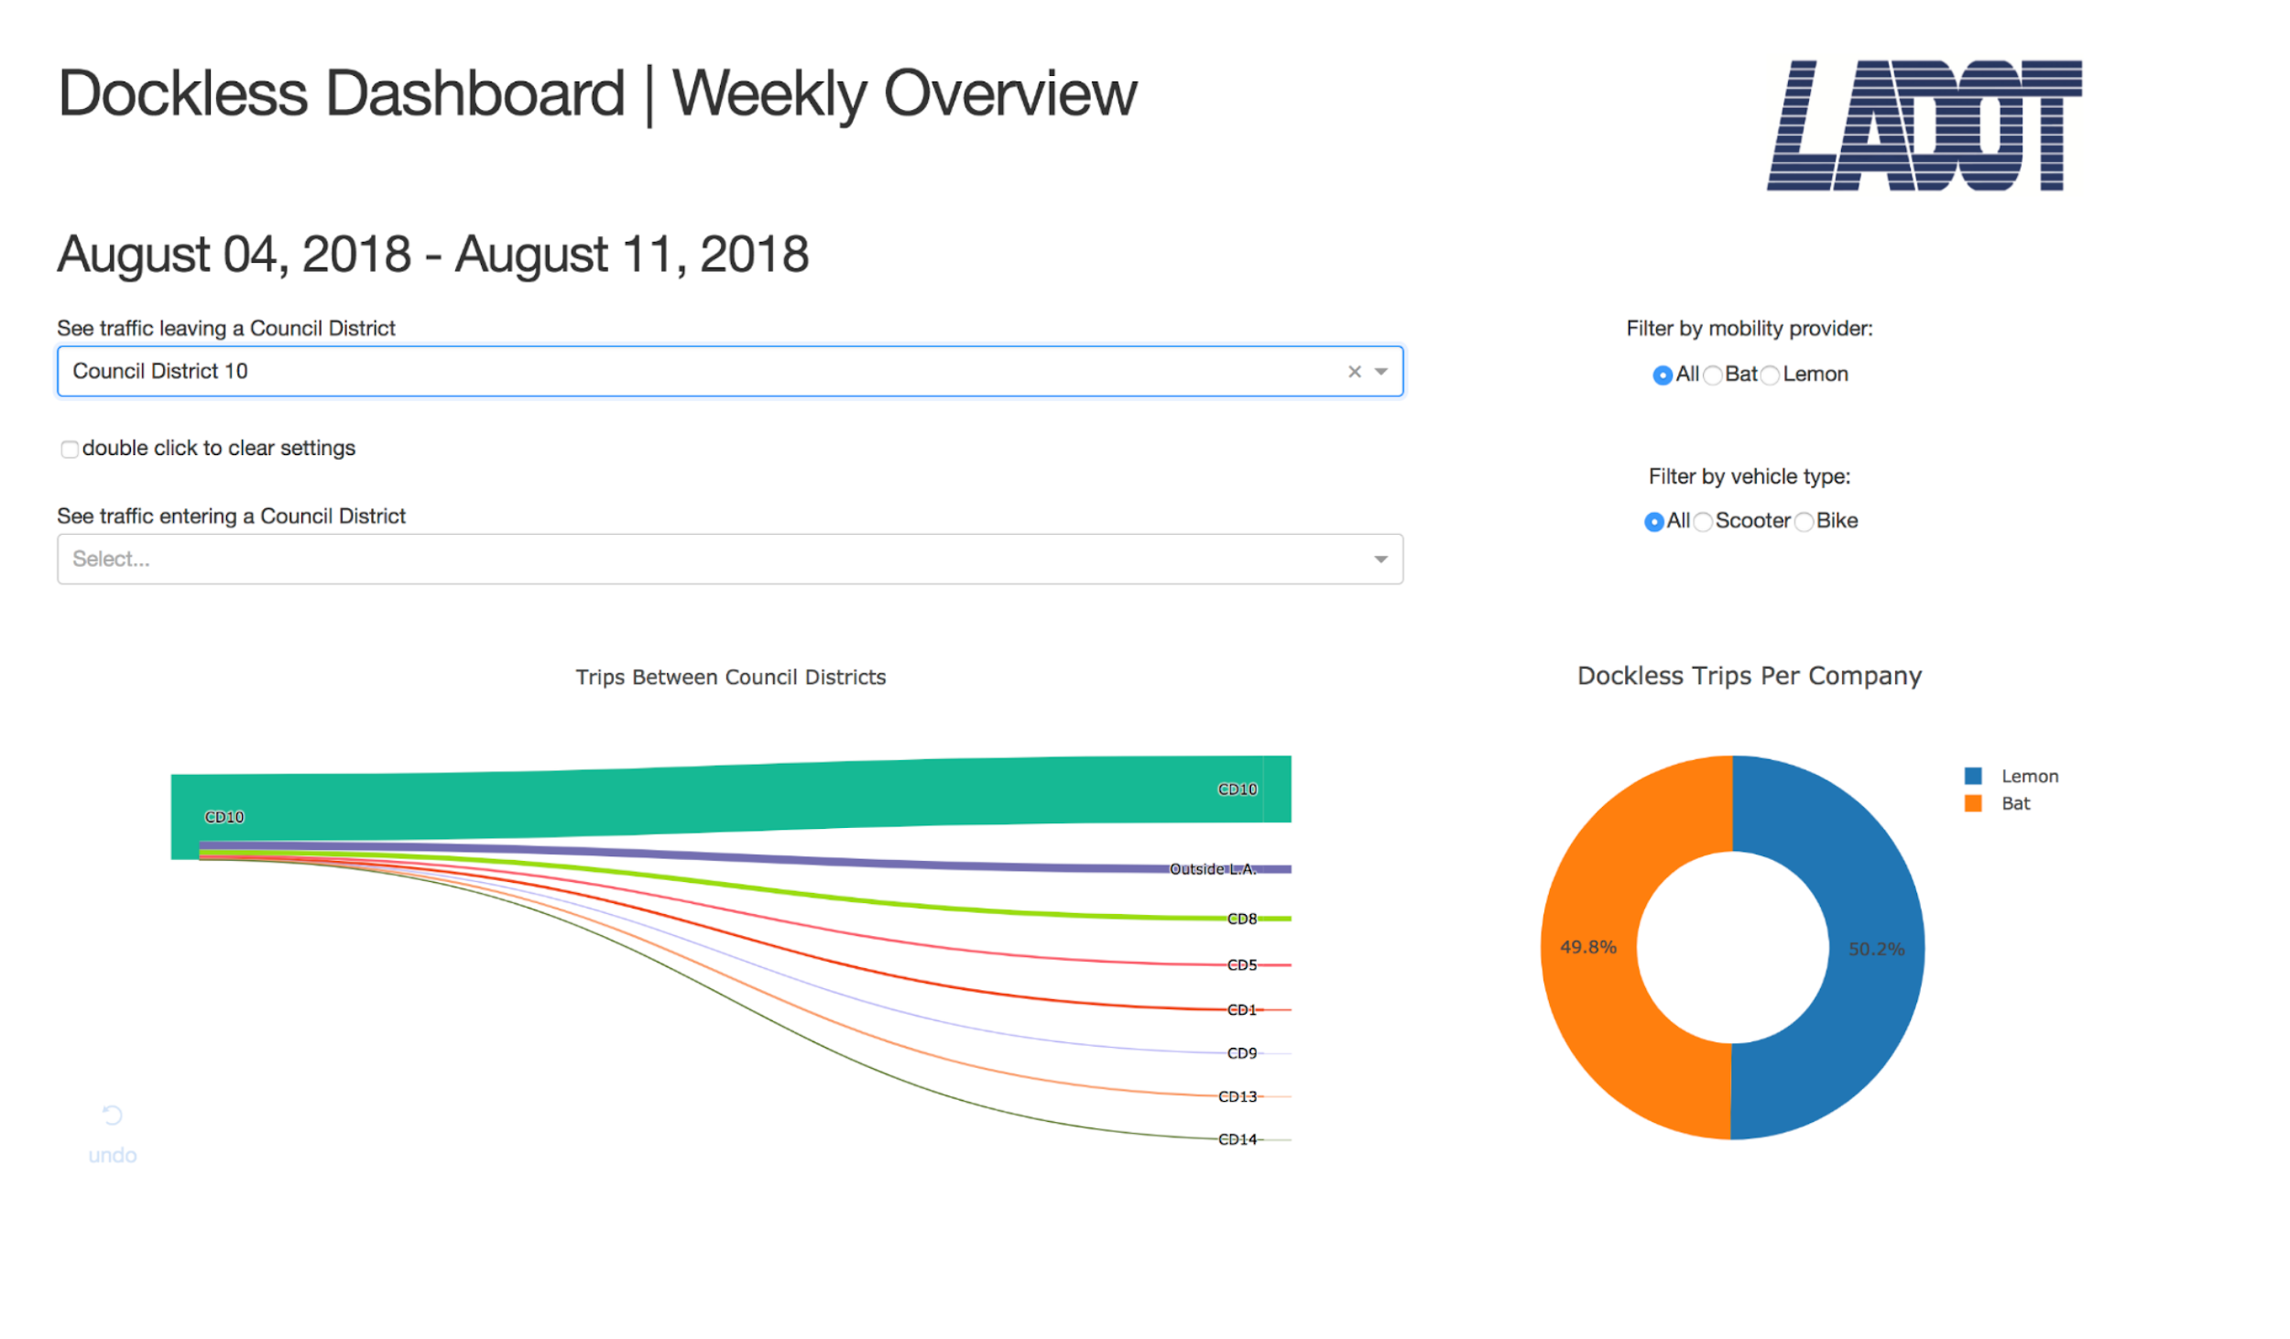
Mobility Data Specification (MDS)
Dashboard Demo
Notes:
In May 2018 we released the Mobility Data Specification was released on Github to allow for opensource collaboration
So what is Github you might be asking? If you have heard of Bitcoin you have heard of Github. It is what was used to create it.
Github is like Wikipedia for programmers. You can edit files, see who changed what, view old versions of files, and access it from anywhere in the world.
Github allows groups of developers to collaborate on the same programming scripts simultaneously and without overriding each other’s work.

Slide 15
Workforce Training and Culture
Embrace Technology and Innovation
Leadership Training
Data Working Group
Data Inventory Training
Data Fluency Training
GIS Training
New Worker Classification (Data Scientist)

Slide 16
New Procurement Process
Technology Bench
Over 90 Companies
OEMs – Ford, Volvo, GM, etc.
On-board quickly (months vs years)
Co-create, Co-iterate and Co-innovate
New Partnership Opportunities

Slide 17
Pilots and Demos
Microtransit in downtown LA
AV shuttle demo
ATCMTD Grant
Mobility Hubs Grant
Electrification of Transit Fleet
Code the Curb Pilot
Framework for Urban Aviation

Slide 18
What else is LADOT Doing?
COALITION MEMBERS
METRO
CALTRANS
CITY OF LOS ANGELES
SCAG
COUNTY OF LOS ANGELES
CITY OF PICO RIVERA

Slide 19
What is the End Goal?
We want these outcomes:
Save Lives
Environmental Sustainability
Energy Efficiency
Social Equity
Partner with Private Companies
Seat at the table
Co-Create
Co-Iterate
Co-Innovate
Scale-Up
Shared
Autonomous
(Artificial Intelligence)
Electrified

